Slide 1

Basics of Neural Network Programming
Broadcasting in
Python
deeplearning.ai
Notes:
<number>

Slide 2
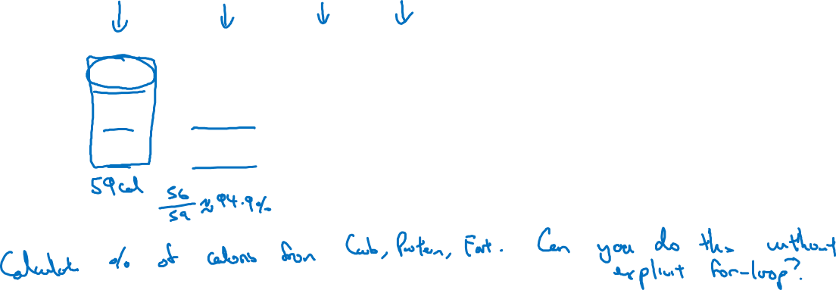
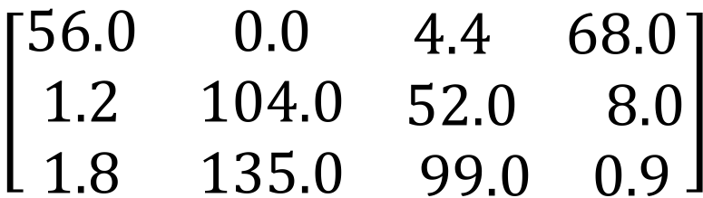
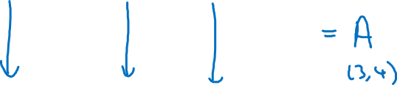
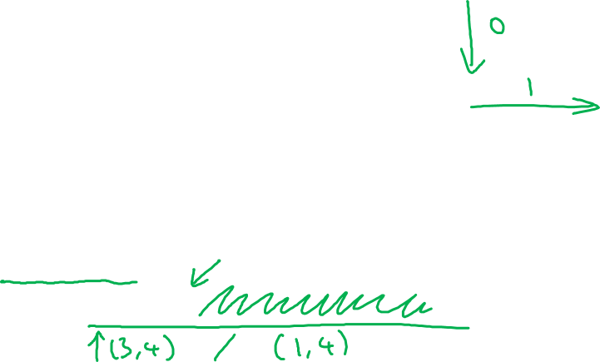
Broadcasting example
Calories from Carbs, Proteins, Fats in 100g of different foods:
Apples
Beef
Eggs
Potatoes
Carb
Protein
Fat
cal = A.sum(axis = 0)
percentage = 100*A/(cal.reshape(1,4))

Slide 3

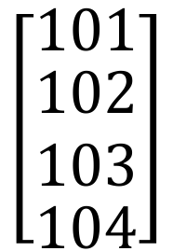
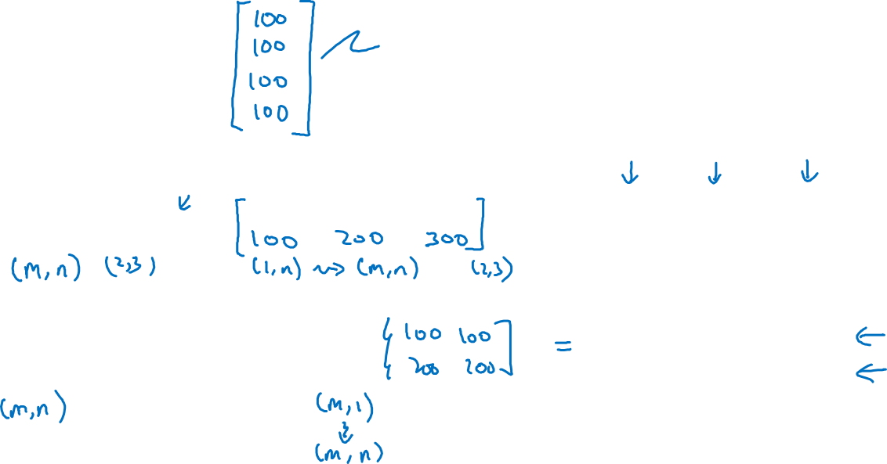

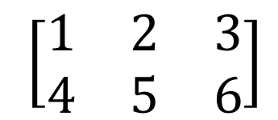

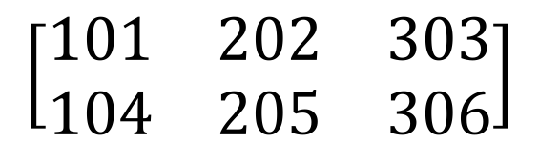
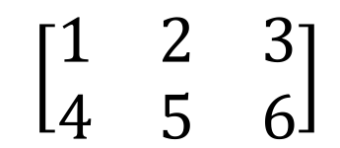
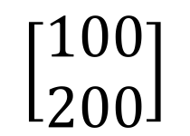
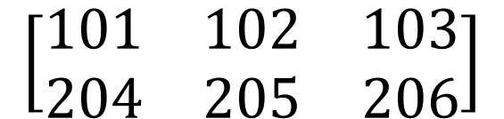
Broadcasting example
=
+
+
=
+
=

Slide 4
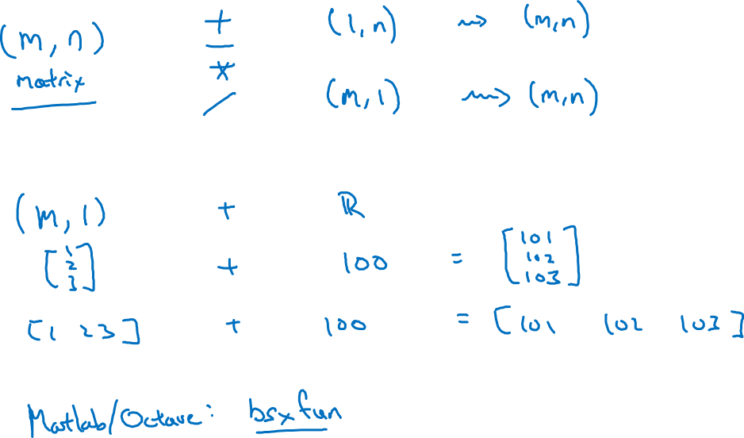
General Principle

